Slide 1
Marriage Customs in China vs
Marriage Customs in the US
Maddox Short

Slide 2
Key Terms
Wedding (ceromony)
Get married
Bride
Groom
婚礼
hūnlǐ
结婚
jiéhūn
新娘
xīnniáng
新郎
xīnláng
Bridesmaid
Best man
Newlyweds
Double happiness
伴娘
bànniáng
伴郎
bànláng
新人
Xīnrén
喜喜
shuāngxǐ

Slide 3


The Proposal
Groom gifts the bride’s family with items like wine, jewelry, sesame seeds, and tea leaves as a symbol of good fortune/prosperity.
The bride’s family gives back half of the gifts, accepting the proposal. This signifies that they intend to have a positive relationship with the groom’s family.
  Historically, matchmakers (elder family members and professional) were involved in determining who someone would marry. The couple had little involvement in the marital process.
  Chinese Zodiacs are traditionally used to determine compatibility within a potential marriage.
  Marriage markets are set up weekly for parents and grandparents to find a spouse for their children. The largest marriage market is in People’s Park, Shanghai every Sunday for the last 20 yrs.

Slide 4
The Proposal
In Western cultures, an engagement ring is typically worn before marriage.
Traditionally, the proposer goes down on one knee to ask for one's hand in marriage. This practice likely originates from the middle ages, where getting down on one knee signified respect and devotion.
70% of proposers still ask for a blessing before they propose. This tradition originated because marriages were viewed as strictly business relationships between the two families, and the brides were considered property. Now, this practice is more of a sign of respect as a blessing, rather than permission.

Slide 5
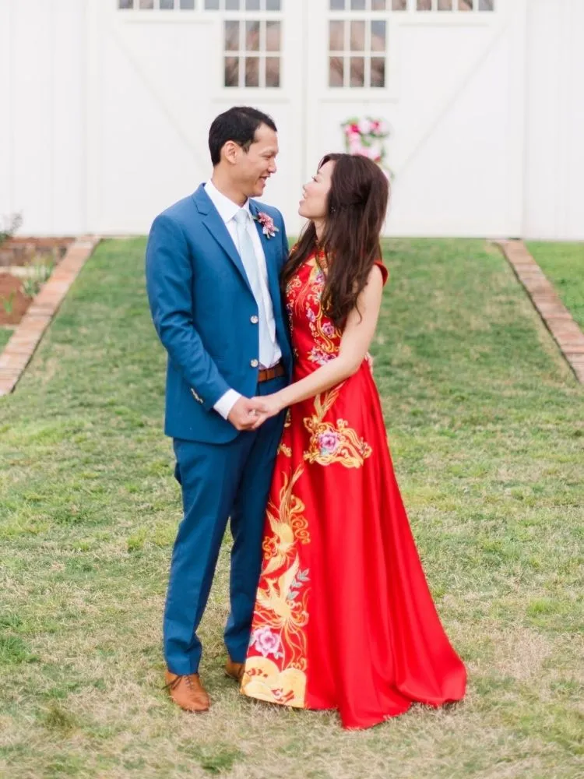
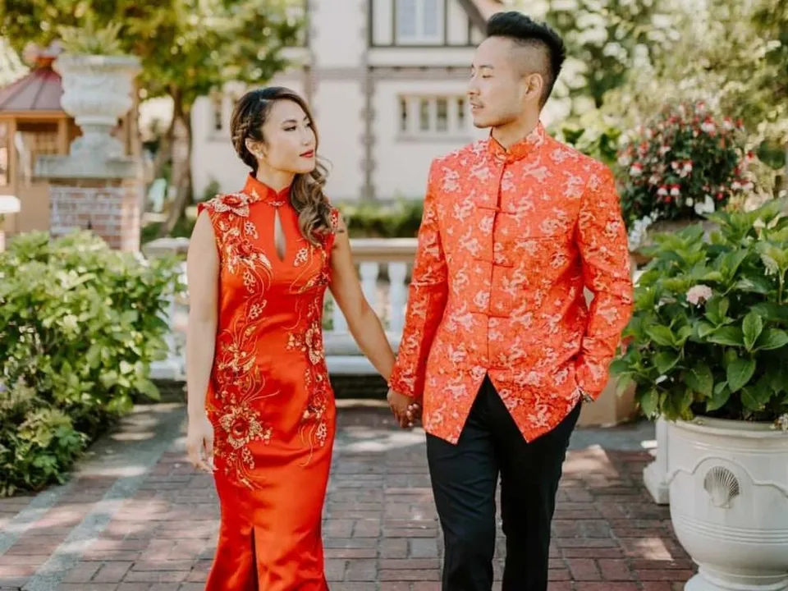
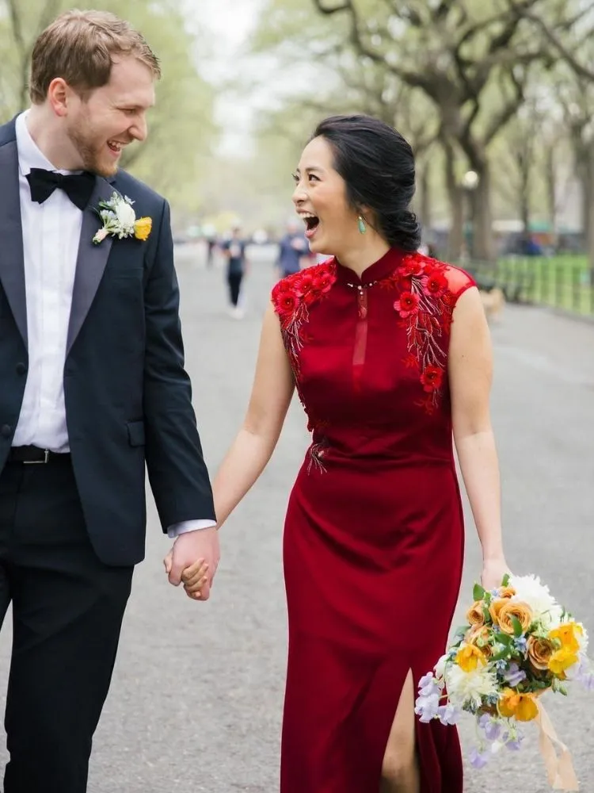
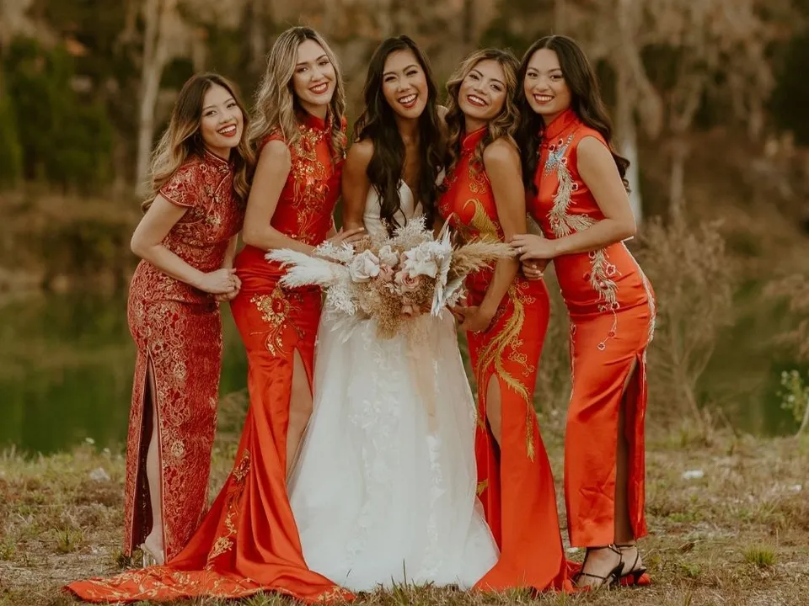
Lucky Colors
Red and gold are the most prominent colors in Chinese weddings. Red symbolizes success, fertility, love, loyalty, and honor. Gold symbolizes wealth.
Wedding guests are to refrain from wearing red, black, and white to the ceremony. Red is reserved for the couple, as bridal dresses tend to be red.
Black and white are typically worn to funerals, so it is considered bad luck if worn to a wedding. Guests tend to wear purple, pink, or other warmer colors. Dark colors in general should be avoided when attending a Chinese wedding!
qipao

Slide 6
Color Pallets in the US
Wedding dresses in the US are typically white. This practice originated in 1840 when Queen Victoria married Prince Albert. Additionally, white signifies purity and virtue, which has led to the white wedding dress custom.
Beyond the typically white dress, 81% of couples incorporate their own color pallet in their wedding. The top 5 wedding colors of 2022 were, gold, ivory/champagne/white, dark blue, light pink, and green.

Slide 7
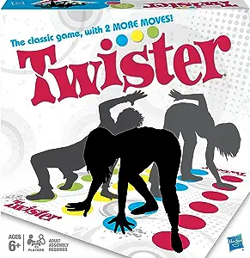
Door Games and the Test
Door games originate from the thought that the bride’s family will not marry her off unless the groom is worthy enough, so he had to pass tests in order to receive her hand in marriage.
Now, door games are usually organized by the bridesmaids. Challenges are set up for the groom and the groomsmen to go through before they can enter into the bride’s house.
  Some examples include, composing a love song, push ups, a game of twister, and waxing the groom’s legs.

Slide 8
Bachelor/Bachelorette Parties
The first bachelor party dates back to 5 B.C. in Sparta. Where a feast, in the groom’s honor, was held the night before his wedding.
Beginning in the 16th century, bridal showers, which involve family members and are typically more formal events, were common within Europe.
The term bachelor party was coined in a Scottish magazine in 1922, but bachelorette parties were not common until the 1960s during women’s liberation.

Slide 9
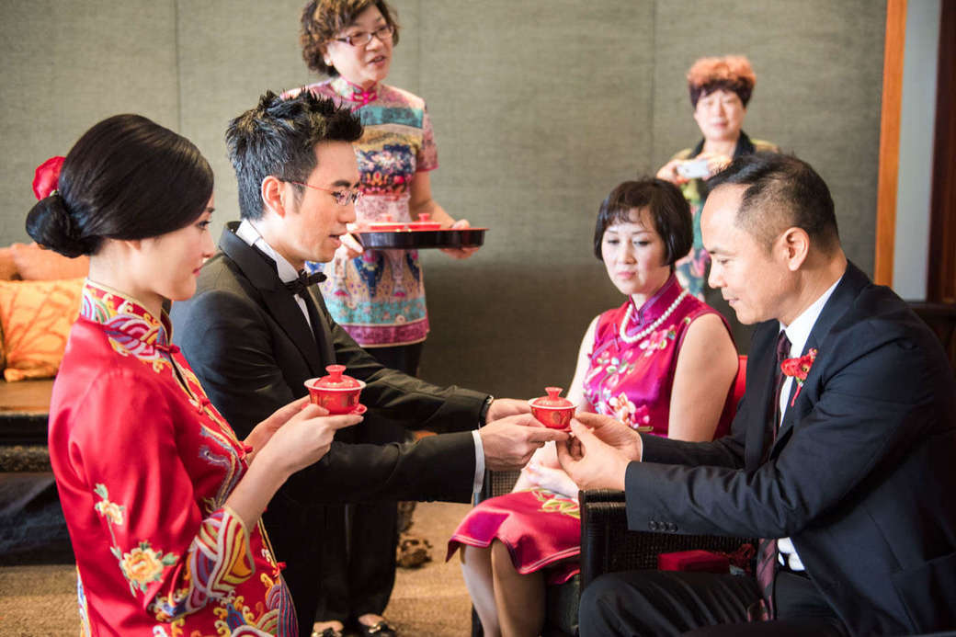
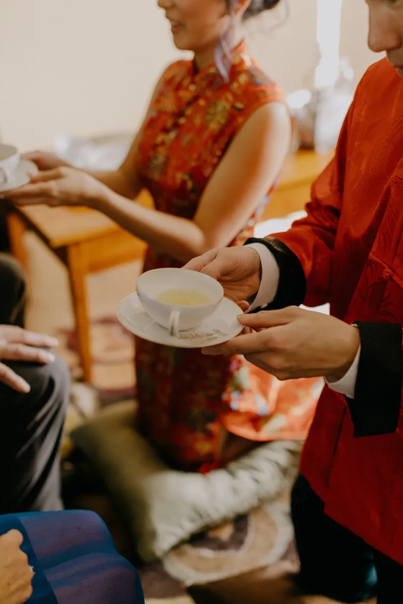
The Tea Ceremony
Tea is served to the elders of the couple, and well wishes/advice is shared with the young couple.
The couple kneels to serve their parents and in laws tea, to honor their parents. Additionally, the couple serves tea to all of the elders in their family. (Tea is served to paternal relatives prior to their maternal relatives)
Historically, the couple stood at a family alter, to honor heaven, earth, their ancestors, and Tsao Chün. Then, the couple would bow to each other.

Slide 10
Hair Combing
The night before the wedding, the bride and groom shower using pomelo leaves, cleansing off negative spirits. They then change into red clothing.
The bride then sits in front of a window or mirror and the groom sits facing the interior of the home. Their parents gather red candles, scissors, incense, ruler, comb, and red yarn (with cypress leaves)
A woman lights the incense and candles, and begins combing the bride’s hair, reciting these blessings:
“May the first comb bring you a long-lasting union
May the second comb bring you a harmonious union
May the third comb bring you an abundance of descendants
May the fourth comb bring you prosperity and longevity”
After the hair is combed 4 times, the woman clips the red yarn into their hair.

Slide 11
Marriage Superstitions
The number four should be avoided
It is good luck for the bride to cry on her wedding day( the louder the better)
the bride should not wear a dress with pockets on her wedding day, as it that is said to take away her father’s fortune
The bride is not to lend her mirror to anyone
The bride should not attend funerals within four months of her wedding
The bride is not to sleep anywhere but her home for the four months leading up to her wedding
Those born in the year of the tiger were considered unsuitable to attend wedding ceremonies
**These are ancient customs that are not necessarily followed today, but were said to avoid bad luck**

Slide 12
Marriage Superstitions (US)
Something borrowed- wearing /carry something that you borrowed from a woman who is happily married in your life, so that her marital success is passed down to you.
Something old, something new, something borrowed, and something blue.
Not wearing pearls as they signify tears, sadness, and suffering
Crying down the aisle = happiness in the long run
The groom not seeing the bride’s dress before the wedding day
The groom and bride waking up in different locations on the wedding day
A spider on your outfit = good luck!!
Rain on your wedding day = fertility and cleansing
Traditionally, the bride would cut her wedding cake on her own, as it symbolized her virginity and fertility. Now, the couple cuts their cake together to signify setting up their home and caring for your spouse.
Bouquet toss for good luck…whoever catches it will be the next to marry.

Slide 13
Works Cited
“Ultimate Guide to Chinese Wedding Door Games | Nicole Chan.” Www.nicolechanphotography.com, 5 May 2021, www.nicolechanphotography.com/chinese-wedding-door-game/. Accessed 18 Mar. 2024.
“Traditional Chinese Tea Ceremony.” Theknot.com, 2023, www.theknot.com/real- weddings/traditional-chinese-tea-ceremony-photo-23. Accessed 18 Mar. 2024.
“Wedding Customs in China 👰- Exploring Beautiful Traditions.” LTL Beijing, 24 Apr. 2020, ltl- beijing.com/wedding-customs-in-china/#chapter-9. Accessed 18 Mar. 2024.
Fercility Jiang. “Ancient Chinese Marriage Customs.” China Highlights, 2019, www.chinahighlights.com/travelguide/culture/ancient-chinese-marriage-customs.htm.
Fang, Charlene. “12 Chinese Wedding Traditions You Need to Know.” Brides, 14 Sept. 2023, www.brides.com/chinese-wedding-traditions-5077983.
Nowack, Hannah. “Chinese Wedding Attire Basics.” Theknot.com, 19 Nov. 2021, www.theknot.com/content/chinese-wedding-attire-basics.
Tan, Lois. “A Beginner’s Guide to Chinese Wedding Tea Ceremony.” Culturally, www.culturally.co/blog/a- beginner-s-guide-to-chinese-wedding-tea-ceremony. Accessed 18 Mar. 2024.

Slide 14
Works Cited
“21 Simple American Wedding Traditions You Should Know in 2021.” Www.weddingforward.com, 20 July 2023, www.weddingforward.com/american-wedding-traditions/#:~:text=Some%20of%20the% 20popular%20feature es%20of%20American%20marriage. Accessed 19 Mar. 2024.
“5 Reasons You Need to Hire a Proposal Photographer.” WeddingWire, www.weddingwire.com /wedding- ideas/proposal-photographer.
“13 Wedding Superstitions, Explained.” Brides, www.brides.com/wedding-superstitions- 5179231#:~:text=13%20Wedding%20Superstitions%2C%20Explained%201%20Wearing%2 0white.%20Wearing. Accessed 19 Mar. 2024.
The Knot. “50 Wedding Traditions and Superstitions.” Theknot.com, The Knot, 15 May 2008, www.theknot.com/content/wedding-traditions-superstitions-facts-trivia.
Lee, Esther. “What Is a Bachelorette Party? Here’s the Definition, Significance and More.” Theknot.com, The Knot, 15 May 2008, www.theknot.com/content/bachelorette-party-basics.
“Why Do Brides Wear White? | Britannica.” Encyclopædia Britannica, 2019, www.britannica.com/story/why-do-brides- wear-white.
Forrest, Kim. “The 5 Most Popular Wedding Colors Right Now.” Theknot.com, The Knot, 13 June 2018, www.theknot.com/content/most-popular-wedding-colors#:~:text=The%20Most %20Popular%20Wedding %20Colors%20in%202022%201. Accessed 19 Mar. 2024.

